Slide 1
Structuring of Program
UNIT –III
PRINCIPLES OF PROGRAMMING LANGUAGES
PPL - SE SEM II (2016-17)

Slide 2
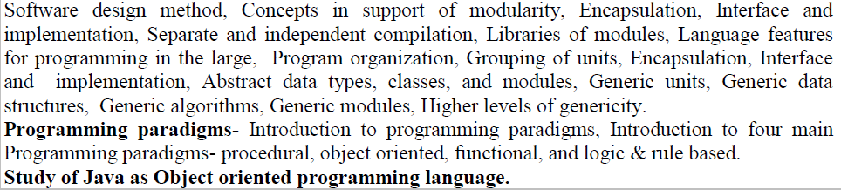
Structuring of Program -Syllabus

Slide 3
Introduction
Programming large systems.
Structuring large programs- Encapsulation. Interfaces, information hiding
Mechanism provided by languages- Packaging, Separate Compilation
Concept of Generality
Fundamental principles – abstraction and modularity

Slide 4
Abstraction And Modularity
Abstraction - understand and analyze program. Concentrate on important aspects and ignoring irrelevant details.
Modularity – Design and built program from smaller pieces (modules).
Divide and Conquer

Slide 5
Cont….
The size of a program is a good indication of the complexity of the problem being solved.
Example: building an airline reservation system
Key requirements
The system has to function correctly at any cost.
The system is “long-lived.”
system undergoes considerable modification
many people—tens or hundreds— are involved in the development

Slide 6
Software design methods
To guide in composing a large program out of smaller units—modules.
Modules should interact with one another in well-defined and controlled ways.
Goal of software design is to find an appropriate modular decomposition of the desired system.
modules should be as independent from each other as possible
Information
hiding

Slide 7
support of modularity
Key to Software Design is Modularization.
A good module
represents a useful abstraction
Interact in well-defined and regular ways
Understood, designed, implemented, compiled
Procedures and functions : breaking a program into two modules

Slide 8
Encapsulation
Program unit provides a service that may be used by other parts of the program, called the clients of the service.
Unit is said to encapsulate the service.
Encapsulation mechanisms are constructs that support the implementation of information hiding modules.
To group together the program components that combine to provide a service and to make only the relevant aspects visible to clients.

Slide 9
Cont…
Module can be described as : Specification and Implementation.
Specification : how the services provided by the module can be accessed by clients.
Implementation : the module’s internal secrets providing the specified services.
In C, a file is the unit of encapsulation.
In C++, Class

Slide 10
Interface and implementation
Clients request the services by a module using the module’s interface, which describes the module’s specification.
Interface specifies the syntax of service requests.
Implementation of the unit is hidden from the client.
In C++, unit of encapsulation is a class,
The interface to the class : interfaces of all the member functions available to clients as well as any other entities

Slide 11
Cont…
In Ada, the unit of encapsulation is a package.
A package encapsulates : < procedures, functions, variables, and types>
Package specification and the package body may appear in different files and need not even be compiled together.

Slide 12
Separate and independent compilation
Independent compilation
Modules may be compiled and tested individually.
For example, C supports independent compilation.
Separate Compilation
compile units individually but subject to certain ordering constraints.
Example : Ada - some units may not be compiled until other units have been compiled.

Slide 13
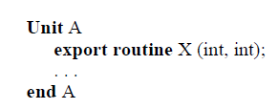
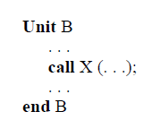
Cont…
A’s interface must be compiled before B
Allow concurrent working on different parts of the program.

Slide 14
Cont…
Impractical to recompile thousands of modules when only a few modules have changed.
In general, programming languages define:
Unit of compilation : what to compile
Order of compilation
Amount of checking between separately-compiled modules

Slide 15
Libraries of modules
Grouping of related services.
Example : library of matrix manipulation routines.
Library collects together a number of related and commonly used services.
Names in different libraries may conflict.
To deal with conflicts : namespaces of C++ and child libraries of Ada
Notes:
onsider a situation, when we have two persons with the same name, Zara, in the same class. Whenever we need to differentiate them definitely we would have to use some additional information along with their name, like either the area if they live in different area or their mother or father name, etc.
Same situation can arise in your C++ applications. For example, you might be writing some code that has a function called xyz() and there is another library available which is also having same function xyz(). Now the compiler has no way of knowing which version of xyz() function you are referring to within your code.
A namespace is designed to overcome this difficulty and is used as additional information to differentiate similar functions, classes, variables etc. with the same name available in different libraries. Using namespace, you can define the context in which names are defined. In essence, a namespace defines a scope.

Slide 16
#include <iostream> using namespace std; // Variable created inside namespace namespace first { int val = 500; } // Global variable int val = 100; int main() { // Local variable int val = 200; // These variables can be accessed from // outside the namespace using the scope // operator :: cout << first::val << '\n'; return 0; }
Output
500
Notes:
using namespace std;
// Variable created inside namespace
namespace first
{
int val = 500;
}
// Global variable
int val = 100;
int main()
{
// Local variable
int val = 200;
// These variables can be accessed from
// outside the namespace using the scope
// operator ::
cout << first::val << '\n';
return 0;
} Definition and Creation: Namespaces allow us to group named entities that otherwise would have global scope into narrower scopes, giving them namespace scope. This allows organizing the elements of programs into different logical scopes referred to by names.
Namespace is a feature added in C++ and not present in C.
A namespace is a declarative region that provides a scope to the identifiers (names of the types, function, variables etc) inside it.
Multiple namespace blocks with the same name are allowed. All declarations within those blocks are declared in the named scope.

Slide 17
Language features for programming in the large

Slide 18
aspects of each language based on the following points:
Module Encapsulation: What is the unit of modularity and encapsulation supported by the language?
Separation of interface from implementation: What is the relationship among modules that form a program?
Program Organization and Module Groupings: How independently can physical modules be implemented and compiled?

Slide 19
Encapsulation in C
Unit of encapsulation in C is a file.
Use of extern specifier.
Use of static specifier.

Slide 20
Program organization in C
One of the files (only) must contain a function named main, which is called to start the program.
Functions are not allowed to be nested in C.
Global Names
A module wanting to use an entity that is defined externally must declare such entities as ……
extern int maximum_length;
A module wanting to limit the scope of one of its defined entities to be local to itself, defined as…..
static int local_size;

Slide 21
Interface and implementation in C
The C unit of physical modularity is a file.
Logical module is implemented by two physical modules (files)- interface and its implementation
Interface, called a “header” or an “include” file.
Header File : Contains the information necessary to satisfy the type system when the client modules are compiled.
Implementation file : contains the private part of the module and implements the exported services.
The function definition appears in implementation file.

Slide 22
Encapsulation in C++
Unit of logical modularity in C++ is the class.
Class defines new (user-defined) data type and encapsulated unit.
Entities either public, private or protected.
Classes may be nested.
Classes and functions may be generic, supporting a generic programming style.

Slide 23
Program organization in C++
The main program or a client creates instances of the classes and calls on them to perform the desired task.
The implementation separates the interface and the implementation in different files.

Slide 24
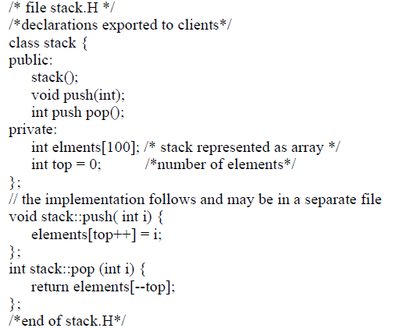

Slide 25
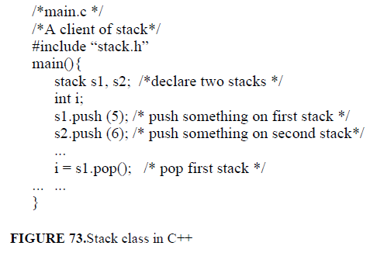
1. Main program, variables of language-defined types are declared.
2. Dot notation
3. Definition of push and pop may appear in the class body or outside of it.
4. Compiler will try to expand the code of the member functions in-line

Slide 26
Interface and implementation in C++
C++ supports the development of independent modules.
A class’s interface and implementation may be separated and even compiled separately from each other.
Client modules may be compiled with access to only the interface modules of the service providers and not their implementation modules.
Any names defined in a class are local to the class unless explicitly declared to be public.

Slide 27
Grouping of units in C++
C++ has several mechanisms for relating classes to each other.
First, classes may be nested.
Two other mechanisms, “friend” functions and namespaces.

Slide 28

Function is defined outside that class' scope but it has the right to access all private and protected members of the class.
Even though the prototypes for friend functions appear in the class definition, friends are not member functions.
A friend can be a function, function template, or member function, or a class or class template, in which case the entire class and all of its members are friends.
Notes:
A friend function of a class is defined outside that class' scope but it has the right to access all private and protected members of the class. Even though the prototypes for friend functions appear in the class definition, friends are not member functions.
A friend can be a function, function template, or member function, or a class or class template, in which case the entire class and all of its members are friends.
To declare a function as a friend of a class, precede the function prototype in the class definition with keyword friend .
To declare all member functions of class ClassTwo as friends of class ClassOne, place a following declaration in the definition of class ClassOne:
friend class ClassTwo;
Ig breaks d natural encapsualtion. It is best used in opertor overloading.

Slide 29
namespaces
It is a declarative region that provides a scope to the identifiers (the names of types, functions, variables, etc) inside it.
C++ partitions the global name space into a smaller groups; each group is called a namespace.
Names are independent from those in any other
namespace and may be referenced by supplying the name of the namespace.
All the files in the C++ standard library declare all of its entities within the std namespace.
Notes:
The package is Ada’s unit of modularity.
ML also supports the concept of generic modules or structures.

Slide 30
Abstract data types, classes, and modules
The name of the class is used as the type name to instantiate the objects necessary.
Operations are performed directly on the instantiated objects, e.g. s1.push(...).
In a module-based language, the need for a construct such as friend functions does not appear.
A object-based language makes it difficult to deal with operations that do not belong clearly to a single type.
Notes:
In a module-based language, the need for a construct such as friend functions does not appear: we simply put all the related functions and types in the same module and they gain visibility to each other.

Slide 31
Generic units
Genericity as a mechanism for building individual modules that are general and thus usable in many contexts by many clients.
Generic data structures
Generic algorithms
Generic modules
Higher levels of genericity

Slide 32
Generic data structures
Development of libraries of standard data structures, for example, stacks and queues.
C++ templates and Ada generics.
The template of C++ allows to define parameterized type.
C++’s template facility is particularly general as it uses classes as parameters and classes represent types uniformly:
Template can be instantiated with either user-defined or primitive types.

Slide 33
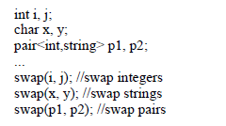
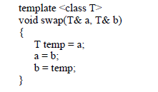
Generic algorithms
Generic routines allow us to parameterize algorithms and achieve a higher level of generality by capturing an algorithm in a type-independent way.

Slide 34
Generic modules
Data and algorithms may also be packaged together.
Both C++ classes and Ada packages may be defined as generic in the types.
C++ can create generic stack with generic push an pop operations.
Ada supports creation of generic modules by creating generic produres.

Slide 35
Higher levels of genericity
Algorithm that works on different types of data structures, not jusSt different data types.
For example, to write one algorithm to do a linear search in any “linear” data structure.
A high level of genericity is usually associated with functional languages (like ML).
There are no particular language facilities in Ada or C++ for this kind of programming.

Slide 36
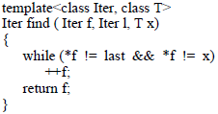
Cont…
The flexibility of C++ templates, combined with overloading of operators supports a high degree of generic programming.
An iterator as a generalization of a C++ pointer.
It reduces the amount of code to be written.

Slide 37
PROGRAMMING PARADIGMS

Slide 38
Agenda
Programming paradigms
Different types of programming paradigms

Slide 39
PROGRAMMING PARADIGMS
Today, computer languages are categorized according to the approach they use to solve a problem.
A paradigm, therefore, is a way in which a computer language looks at the problem to be solved. Or
A programming paradigm is a style or “way” of programming.
Divide computer languages into four paradigms:
Procedural programming language
Object-oriented programming
Functional or application programming
Declarative or logical programming.

Slide 40
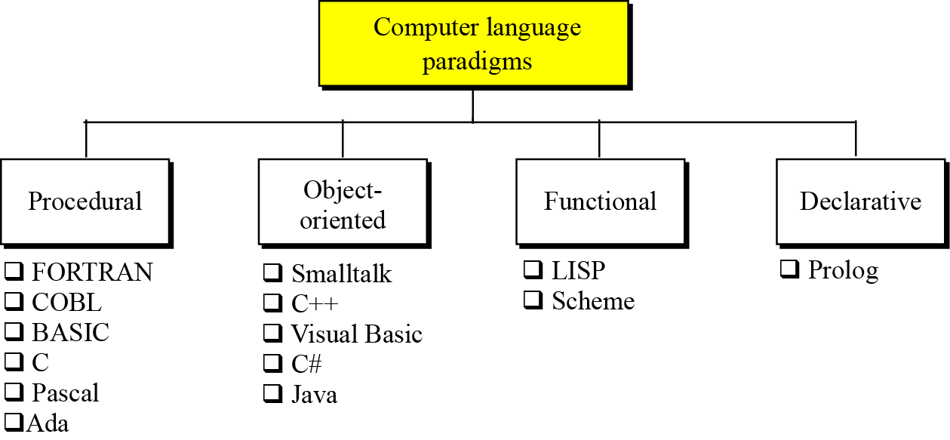
Categories of programming languages

Slide 41
Procedural Paradigm
First do this and next do that
It is also known as imperative paradigm
command driven or statement oriented languages.
Execution of each and every statement cause the computer to change the value of one or more location in its memory, i.e. to enter a new state.
Imperative programs describe
the details of HOW the results are to be obtained, in terms of the underlying machine model.
Statements, which explicitly change the state of the memory of the computer.

Slide 42
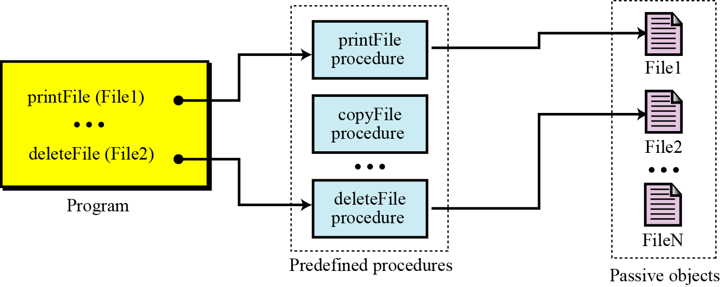
The concept of the procedural paradigm
Notes:
A program in a procedural paradigm is an active agent that uses passive objects that we refer to as data or data items. To manipulate a piece of data, the active agent (program) issues an action, referred to as a procedure. For example, think of a program that prints the contents of a file. The file is a passive object. To print the file, the program uses a procedure, which we call print.

Slide 43
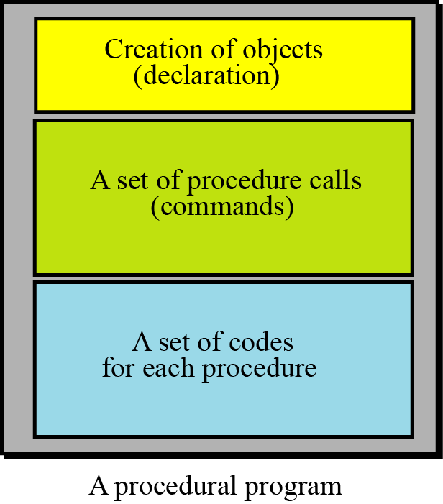
The components of a procedural program
Notes:
A program in this paradigm is made up of three parts: a part for object creation, a set of procedure calls and a set of code for each procedure. Some procedures have already been defined in the language itself. By combining this code, the programmer can create new procedures.

Slide 44
Object Oriented Paradigms
The object-oriented paradigm deals with active objects instead of passive objects.
Active objects in our daily life: a vehicle, an automatic door, a dishwasher and so on.
The action to be performed on these objects are included in the object: the objects need only to receive the appropriate stimulus from outside to perform one of the actions.
A file in an object-oriented paradigm.
Notes:
A file in an object-oriented paradigm can be packed with all the procedures called methods in the object-oriented paradigm to be performed by the file: printing, copying, deleting and so on. The program in this paradigm just sends the corresponding request to the object.

Slide 45
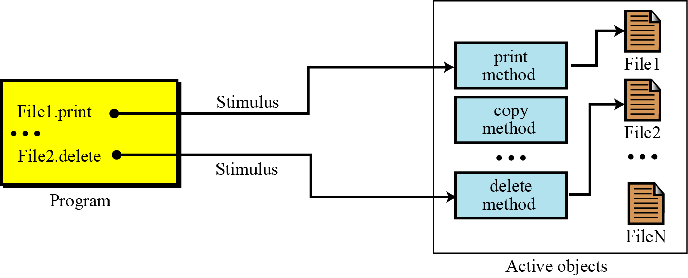
Figure 9.5 The concept of an object-oriented paradigm

Slide 46
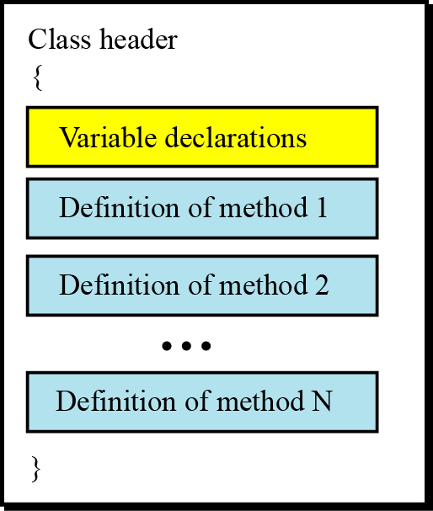
Classes
The concept of an object-oriented paradigm

Slide 47
Methods
In general, the format of methods are very similar to the functions used in some procedural languages.
Each method has its header, its local variables and its statement.
object-oriented languages are actually an extension of procedural languages with some new ideas and some new features.
The C++ language, is an object-oriented extension of the C language.

Slide 48
Inheritance
Classes are usually arranged in some kind of class hierarchy.
An object can inherit from another object.
This hierarchy can be thought of as representing a "kind of" relation.
Notes:
For example, a computational model of the University might need a class person to represent the various people who make up the University. A sub-class of person might be a student; students are a kind of person. Another sub-class might be professor. Both students and professors can exhibit the same kinds of behaviour, since they are both people. They both eat drink and sleep,

Slide 49
Polymorphism
“many forms”.
Define several operations with the same name that can do different things in related classes.
For example, assume that we define two classes, Rectangles and Circles, both inherited from the class GeometricalShapes.
We define two operations both named area, one in Rectangles and one in Circles, that calculate the area of a rectangle or a circle. The two operations have the same name

Slide 50
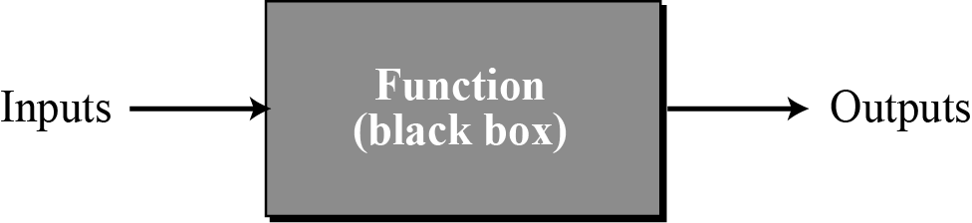
Functional paradigms
In the functional paradigm a program is considered as idea of computation as being about evaluating mathematical functions combined in expressions.
A function in a functional language
The functional paradigm is hard to implement efficiently because if a storage location is once used to hold a value it is not obvious when it can be re-used.

Slide 51
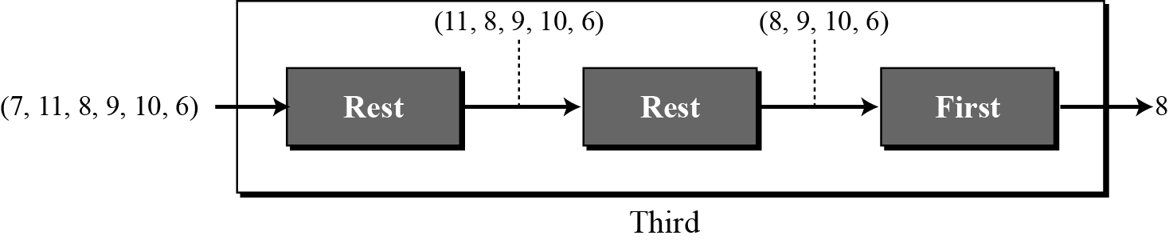
Extracting the third element of a list
Notes:
For example, we can define a primitive function called first that extracts the first element of a list. It may also have a function called rest that extracts all the elements except the first. A program can define a function that extracts the third element of a list by combining these two functions as shown in Figure 9.8.

Slide 52
The Declarative Paradigm
It is based on writing computer programs by specifying what the programs should do, and not how they should do it.
a style of building the structure and elements of computer programs—that expresses the logic of a computation without describing its control flow.
In this program is a theory in some suitable logic.
programmer can concentrate on stating what is to be computed, not necessarily how it is to be computed.

Slide 53
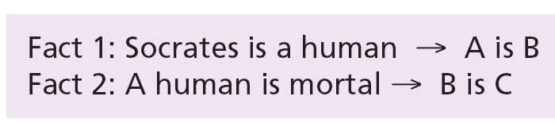
Using this rule and the two following facts,
we can deduce a new fact:

Slide 54
JAVA as Object Oriented Programming Language

Slide 55
Some Salient Characteristics of Java
Java is platform independent: the same program can run on any correctly implemented Java system
Java is object-oriented:
Structured in terms of classes, which group data with operations on that data
Can construct new classes by extending existing ones
Java designed as
A core language plus
A rich collection of commonly available packages
Java can be embedded in Web pages

Slide 56
Java Processing and Execution
Begin with Java source code in text files: Model.java
A Java source code compiler produces Java byte code
Outputs one file per class: Model.class
May be standalone or part of an IDE
A Java Virtual Machine loads and executes class files
May compile them to native code (e.g., x86) internally

Slide 57
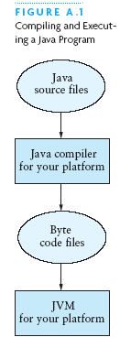
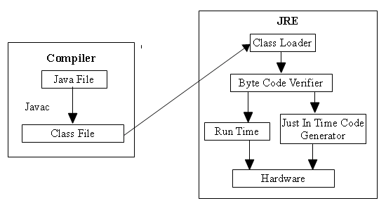
Compiling and Executing a Java Program

Slide 58
Classes and Objects
The class is the unit of programming
A Java program is a collection of classes
Each class definition (usually) in its own .java file
The file name must match the class name
A class describes objects (instances)
Describes their common characteristics: is a blueprint
Thus all the instances have these same characteristics
These characteristics are:
Data fields for each object
Methods (operations) that do work on the objects

Slide 59
Concept: An object has behaviors
In old style programming, you had:
data, which was completely passive
functions, which could manipulate any data
An object contains both data and methods that manipulate that data
An object is active, not passive; it does things
An object is responsible for its own data
But: it can expose that data to other objects

Slide 60
Grouping Classes: The Java API
API = Application Programming Interface
Java = small core + extensive collection of packages
A package consists of some related Java classes:
Swing: a GUI (graphical user interface) package
AWT: Application Window Toolkit (more GUI)
util: utility data structures (important to CS 187!)
The import statement tells the compiler to make available classes and methods of another package
A main method indicates where to begin executing a class (if it is designed to be run as a program)

Slide 61
Concept: Classes are like Abstract Data Types
An Abstract Data Type (ADT) bundles together:
some data, representing an object or "thing"
the operations on that data
Example: a CheckingAccount, with operations deposit, withdraw, getBalance, etc.
Classes enforce this bundling together

Slide 62
Concept: Objects inherit from their superclasses
A class describes fields and methods
Objects of that class have those fields and methods
But an object also inherits:
the fields described in the class's superclasses
the methods described in the class's superclasses
A class is not a complete description of its objects!

Slide 63
Example of inheritance
class Person {
String name;
String age;
void birthday () {
age = age + 1;
}
}
class Employee
extends Person {
double salary;
void pay () { ...}
}
Every Employee has a name, age, and birthday method as well as a salary and a pay method.

Slide 64
Concept: Objects must be created
int n; does two things:
it declares that n is an integer variable
it allocates space to hold a value for n
Employee secretary; does one thing
it declares that secretary is type Employee
secretary = new Employee ( ); allocates the space

Slide 65
What is an Interface?
An interface defines a protocol of behavior that can be implemented by any class anywhere in the class hierarchy.
An interface defines a set of methods but does not implement them. A class that implements the interface agrees to implement all the methods defined in the interface, thereby agreeing to certain behavior.
An interface is a named collection of method definitions (without implementations).
Interface reserve behaviors for classes that implement them.

Slide 66
Methods declared in an interface are always public and abstract, therefore Java compiler will not complain if you omit both keywords
Static methods cannot be declared in the interfaces – these methods are never abstract and do not express behavior of objects
Variables can be declared in the interfaces. They can only be declared as static and final. – Both keyword are assumed by default and can be safely omitted.
Sometimes interfaces declare only constants – be used to effectively import sets of related constants.

Slide 67
Defining an Interface
Defining an interface is similar to creating a new class.
An interface definition has two components: the interface declaration and the interface body.
interfaceDeclaration
{
interfaceBody
}
The interfaceDeclaration declares various attributes about the interface such as its name and whether it extends another interface.
The interfaceBody contains the constant and method declarations within the interface

Slide 68
public interface StockWatcher
{
final String sunTicker = "SUNW";
final String oracleTicker = "ORCL";
final String ciscoTicker = "CSCO";
void valueChanged
(String tickerSymbol,
double newValue);
}
If you do not specify that your interface is public, your interface will be accessible only to classes that are defined in the same package as the interface

Slide 69
Implementing an Interface
Include an implements clause in the class declaration.
A class can implement more than one interface (the Java platform supports multiple inheritance for interfaces), so the implements keyword is followed by a comma-separated list of the interfaces implemented by the class.
When implement an interface, either the class must implement all the methods declared in the interface and its superinterfaces, or the class must be declared abstract .

Slide 70
Properties of Interface
A new interface is a new reference data type.
Interfaces are not instantiated with new, but they have certain properties similar to ordinary classes
You can declare that an object variable will be of that interface type
e.g.
Comparable x = new Tile(…);
Tile y = new Tile(…);
if (x.compareTo(y) < 0) …

Slide 71
Interface Hierarchies
Inheritance can be applied to interfaces as well as classes
One interface can be derived from another interface
The child interface inherits all abstract methods of the parent.
A class implementing the child interface must define all methods from both the ancestor and child interfaces.
All members of an interface are public.
Note that class hierarchies and interface hierarchies are distinct (they do not overlap).

Slide 72
Superinterface (1)
An interface can extend other interfaces, just as a class can extend or subclass another class.
An interface can extend any number of interfaces.
The list of superinterfaces is a comma-separated list of all the interfaces extended by the new interface
public interfaceName
Extends superInterfaces
{
InterfaceBody
}

Slide 73
Superinterface (2)
Two ways of extending interfaces:
Add new methods
Define new constants
Interfaces do not have a single top-level interface. (Like Object class for classes)

Slide 74
Multiple Inheritance
Person
Student
Employee
TeachingAssistant
Multiple inheritance of class is not allowed in Java

Slide 75
What is Package?
A package is a collection of related classes and interfaces providing access protection and namespace management.
To make classes easier to find and to use
To avoid naming conflicts
To control access

Slide 76
Why Using Packages?
Programmers can easily determine that these classes and interfaces are related.
Programmers know where to find classes and interfaces that provide graphics-related functions.
The names of classes won’t conflict with class names in other packages, because the package creates a new namespace.
Allow classes within the package to have unrestricted access to one another yet still restrict access for classes outside the package

Slide 77
Thank You
By Madhuri Kumbhar

